Slide 1


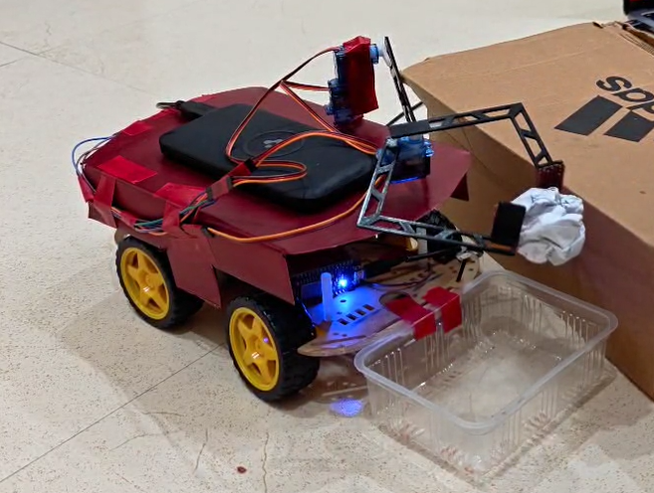
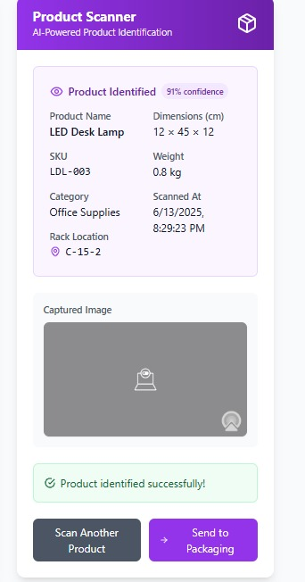
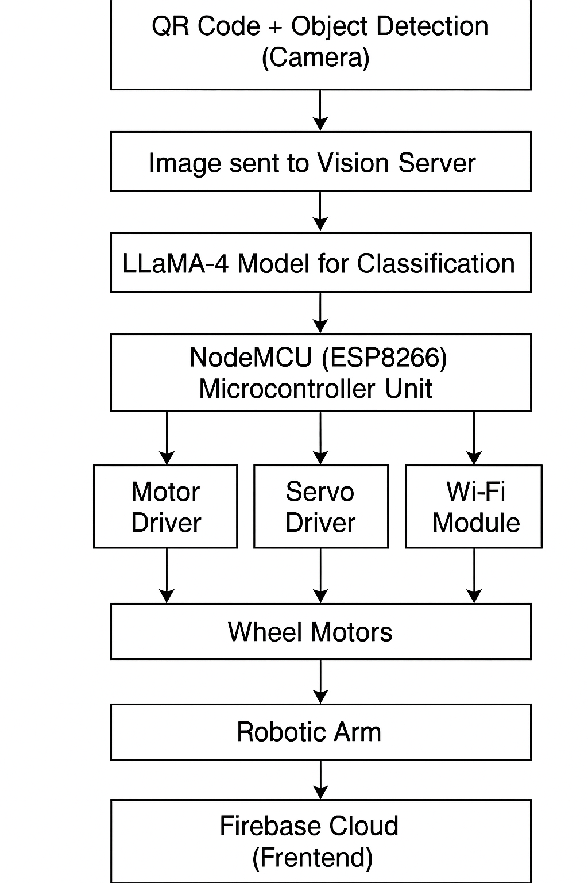


VI SEMESTER INTERDISCIPLINARY PROJECT
Go, change the world
Internet of Things (IOT) Powered Automated Delivery Vehicle with Robotic Arm for Smart Warehousing
QR CODE- includes ppt and working model video
Asish Pavanram Gandrothu | Raghuveer Narayanan Rajesh | Pranav Darshan | Namith Shivananada Gowda | Amish Srivastava | Ashwin Kadloor
1RV22ET009 | 1RV22CS154 | 1RV22CS143 | 1RV22EC099 | 1RV22ME018 | 1RV22ME032
Abstract
Experimentation/Hardware/simulation /Software model
This project presents a cloud-connected autonomous delivery vehicle designed for smart warehouse logistics. Equipped with a three-degrees-of-freedom robotic arm and an onboard vision system, the vehicle performs autonomous pick-and-place tasks. A cloud-integrated IoT dashboard and web interface enable real-time object classification, navigation, and task monitoring. The system demonstrates intelligent automation aligned with Industry 4.0 principles.
Problem Statement
Results
Manual material handling in warehouses is often inefficient, error-prone, and labor-intensive. The increasing demands of e-commerce logistics call for scalable automation solutions that can reduce operational delays, misplacements, and reliance on human supervision. This project addresses these issues by deploying an autonomous robotic platform for precise, real-time warehouse item transport and inventory interaction.
The product scanner module accurately identified an LED Desk Lamp with 91% confidence, retrieving detailed attributes such as dimensions, SKU, and location. This demonstrates the system’s capability to automate inventory classification and streamline routing to packaging within the warehouse workflow.
Objectives
To design a delivery robot that navigates and operates autonomously in a warehouse layout.
To implement real-time object detection and classification using server-based vision models.
To automate pick-and-place operations using a robotic arm.
To enable cloud synchronization and remote access via a web-based dashboard and ensure robustness, modularity, and energy efficiency in real-time conditions.
Methodology
Outcome
Successfully designed and tested a working delivery robot prototype.
Enabled real-time object detection and item pickup autonomously.
Integrated cloud dashboard with frontend UI for user access.
Achieved low-latency, high-accuracy operation in test warehouse setup.
Demonstrated a scalable and affordable Industry 4.0 solution.
References
[1] C. G. C. Carducci, A. Monti, M. H. Schraven, M. Schumacher, and D. Mueller, "Enabling ESP32-based IoT applications in building automation systems," in 2019 II Workshop on Metrology for Industry 4.0 and IoT, pp. 306–311, IEEE, 2019.
[2] M. Dhouioui and T. Frikha, "Intelligent warehouse management system," in 2020 IEEE International Conference on Design & Test of Integrated Micro & Nano-Systems (DTS), pp. 1–5, IEEE, 2020.
[3] M. Farman, M. Al-Shaibah, Z. Aoraiath, and F. Jarrar, "Design of a three degrees of freedom robotic arm," International Journal of Computer Applications, vol. 179, no. 37, pp. 12–17, 2018.
[4] J. Xie, G. Wang, T. Zhang, Y. Sun, H. Chen, Y. Zhuang, and J. Li,"LLaMA-Unidetector: A LLaMA-Based Universal Framework for Open-Vocabulary Object Detection in Remote Sensing Imagery,“ IEEE Transactions on Geoscience and Remote Sensing, 2025.
Signature
Guide Name: Dr. Nanjundaradhya N V
(Professor, Dept. of Mechanical Engineering)
Notes:
1

